Slide 2
Ignite 2017
Great session. Good explanation and examples for a complex topic. Well done.
The information in this sessions was very helpful and certainly exciting that Microsoft is headed in the right direction.
This was the best and most informative presentation of the week.
I didn’t attend this session due to its conflict with another session. As a result I missed some major announcements along with additions to the road map that were not reflected in the title of description.
All I can say is THANK YOU, thank you for listening this was well worth coming. We have needed these features for so long.
Learnt a lot of new cool stuff. Let's have more sessions at this level next year.
Probably the best session of the conference!!!!!!

Slide 3
Hybrid Exchange
BRK3143
Making it easier and faster to move to the cloud
Jeff Kizner
Principle PM Manager

Slide 4
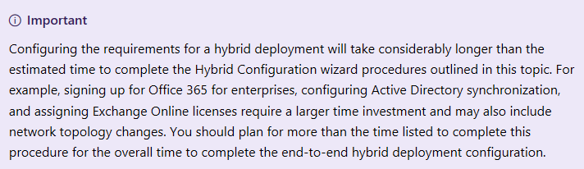
The Hybrid Challenge
It’s necessary, but it’s hard.

Slide 5


Administration and Configuration
#*@$?
#*@$?
Mike prepares to onboard his users to EXO.
On-prem customization is not transferred to EXO. Unsure about the user experience, migrations are delayed.
Sara is not pleased that her business cannot onboard to O365 quickly!
Mike spends weeks customizing EXO to match the on-prem policies before he can move to migrations

Slide 6
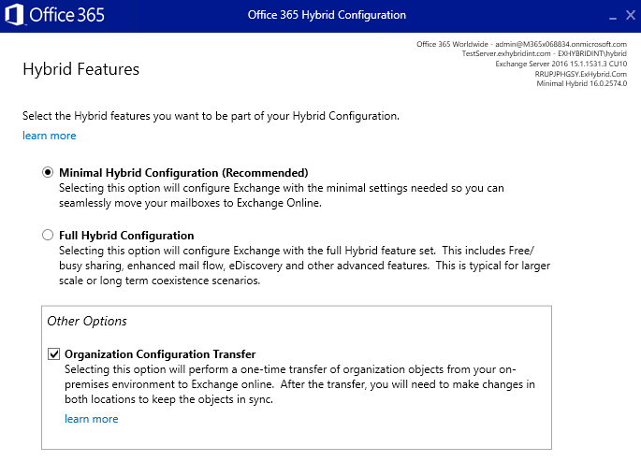
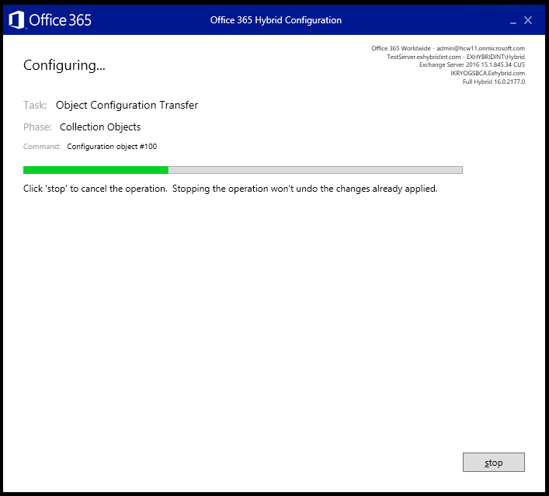
Organization Configuration Transfer
OCT v1 – Released June 2018
One time copy of Org Config objects to EXO
Sub set of policies & objects
  Retention Policy
  Retention Policy Tags
  OWA Mailbox Policy
  Mobile Device Mailbox Policy
  Active Sync Mailbox Policy
New-* actions only

Slide 7
Organization Configuration Transfer v2
Demo

Slide 8
Organization Configuration Transfer v2
Coming to the HCW Soon!
One time copy of Org Config objects to EXO
Set-* actions added
Sub set of policies & objects
  Retention Policy
  Retention Policy Tags
  OWA Mailbox Policy
  Mobile Device Mailbox Policy
  Active Sync Mailbox Policy
  DLP Policy
  Organization Config
  Active Sync Device Access Rule
  Active Sync Organization Settings
  Malware Filter Policy
  Policy Tip Config
  Address List

Slide 9
Hybrid Setup and Onboarding
Sign up for Exchange Online
Read the 20 different pages on Docs about hybrid
Create a DFD
Review with your networking team
Review with your security team
Update the DFD config when we publish new IPs
Re-review with networking
Deploy some new “Exchange hybrid servers”
Argue with security about installing Exchange in the DMZ
Create some new DNS records
Create some inbound firewall flows
Run the HCW (with OCT!)
Test some flows for onboarding and free/busy
Go back to the networking team to fix some inbound flows missed
Security team puts the project on hold and shuts down connectivity
Etc…

Slide 10

Hybrid Setup and Onboarding
Signup for Exchange Online
Run the HCW
Move Mailboxes

Slide 11

Fixing Hybrid
Keep it simple
Start simple, prove the model, create a platform
Don’t change Exchange authentication, authorization, or throttling
Fix/eliminate the most common problems
  No customer DNS changes
  No certificate changes
  No firewall/network changes
  Protect On-Prem systems

Slide 12
Hybrid Agent Demo

Slide 13
Hybrid Agent
Outbound ACL Only
Hybrid Proxy Service
IP Whitelist
Hybrid Agent
Tenant-specific endpoint:
https://{guid}.resource.{flow}.his.msappproxy.net
Exchange Online
Exchange Servers
  No customer DNS changes
  No certificate changes
  No firewall/network changes
  Protect On-Prem systems
On-Premises Environment

Slide 14
Hybrid Agent - Availability
Hybrid Proxy
[No Change] Free Busy requests from On Prem to Cloud reach out to internet
[Change] Free Busy request from Cloud to On Prem are routed via the Hybrid Agent with the use of the –TargetSharingEPR parameter in Org Rel & IOC:
Identity : O365 to On-premises
DomainNames : {QFQNNTWSOE.Exhybrid.com}
TargetApplicationUri : FYDIBOHF25SPDLT.QFQNNTWSOE.Exhybrid.com
TargetSharingEpr : https://a28c52a4-a3e4-46af-bfabf7cfce277ef3.resource.freebusy. his.msappproxy.net/EWS/Exchange.asmx
TargetAutodiscoverEpr : https://qfqnntwsoe.exhybrid.com/autodiscover/autodiscover.svc/WSSecurity
Exchange Online
Hybrid Agent
Exchange Server

Slide 15
Hybrid Agent - Migration
Hybrid Proxy
[Change] Use proxy endpoint for RemoteServer
New-MigrationEndpoint -Name OPtoCloud_HybridService -ExchangeRemoteMove -RemoteServer A28C52A4-A3E4-46AF-BFAB-F7CFCE277EF3.resource. mailboxmigration.his.msappproxy.net
Exchange Online
Hybrid Agent
Exchange Server

Slide 16
Hybrid Agent Setup

Slide 17
Hybrid Agent - Setup Details
HCW
Exchange Server
Download the agent MSI
Do basic install stuff
Register agent
Configure agent
Validate agent for Exchange
Complete configuration
Hybrid Agent
Hybrid Agent Installer
Exchange Online
Hybrid Proxy Service

Slide 18

Hybrid Agent v1
V1 supports hybrid f/b and mailbox moves only
V1 will support new hybrid setups only
Install 3 or more agents
Install the agent on existing Exchange servers

Slide 19
Hybrid Agent Platform
Tenant-specific endpoint:
https://{guid}.resource.{flow}.his.msappproxy.net
Hybrid Proxy Service
Hybrid Agent
Exchange Online
Exchange Servers
On-Premises Environment

Slide 20

The Send-As Problem
Mailbox 2 is granted Send-As to Mailbox 1 then Mailbox 1 is moved to the cloud.
Exchange Online
Mailbox 3 is granted Send-As to Mailbox 1 which is now in the cloud.
Mailboxes 2 and 3 move to the
cloud. Mailbox 2 works. Mailbox 3 fails.
Mailbox 4
4. Mailbox 4 has full access to Mailbox 1 then
Mailbox 4 is moved on-premises.
Exchange On-Premises
Mailbox 1
Mailbox 2
Mailbox 3

Slide 21
Hybrid Agent Platform Demo

Slide 22
Take-aways
EXO Hybrid setup has never been easier
Your networking and security teams can bother other people now

Slide 23


Slide 24

Office 365 for IT Pros eBook
Microsoft is sponsoring free copies of the Office 365 for IT Pros eBook and because you stayed to the end of this session, you have a chance to get a copy.
Enter the code below into a browser – and if you’re lucky, you’ll have > 1,000 pages to read about Office 365.
https://gumroad.com/l/O365IT/tothecloudandbeyond

Slide 25
Please evaluate this session
Your feedback is important to us!
Please evaluate this session through MyEvaluations on the mobile app
or website.
Download the app:
https://aka.ms/ignite.mobileApp
Go to the website: https://myignite.techcommunity.microsoft.com/evaluations

